Slide 1
Provable APIs
Q.E.D. Hour 2

Slide 2
Homework
Let M be a movement with 1 degree of freedom.
Let g(M) be the number of gears in M.
Let c(M) be the number of connections in M.
Prove c(M) = g(M)-1.

Slide 3
Start with one gear
Let M₀ be the movement having one gear.
g(M₀) = 1.
c(M₀) = 0.
c(M₀) = g(M₀)-1.

Slide 4
Add one gear
Let M_{j+1} be a movement constructed by adding one gear to M_{j}.
Assume c(M_{j}) = g(M_{j})-1.
Prove c(M_{j+1}) = g(M_{j+1})-1.
g(M_{j+1}) = g(M_{j})+1.
c(M_{j+1}) = c(M_{j})+1.
c(M_{j+1}) = g(M_{j})-1 + 1.
c(M_{j+1}) = g(M_{j+1})-1.
Q.E.D.

Slide 5

Bertrand Meyer
Only through a precise definition of every module’s claims and responsibilities can we home to attain a significant degree of trust in large software systems.

Slide 6

Unhelpful API
Notes:
http://aroundthesphere.wordpress.com/2009/07/14/organs-urgency-money-and-reform/

Slide 7
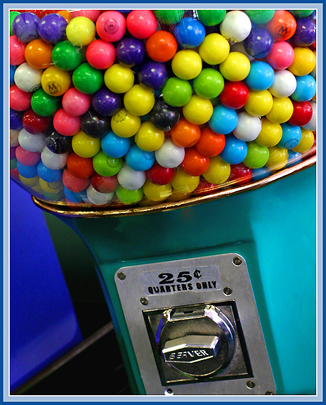
Parameters
Notes:
http://michaelweinberg.com/5new-hitparade1.html

Slide 8

Callbacks
Notes:
http://www.visitingdc.com/city/hollywood-sign-address.asp

Slide 9

Foreign keys

Slide 10
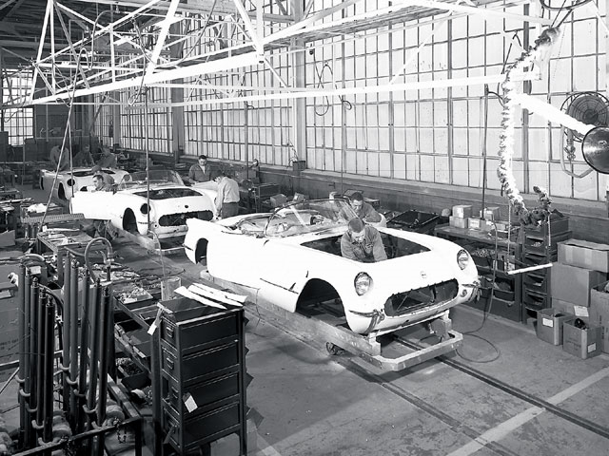
Factories

Slide 11

Constructors
Notes:
http://www.virtualworldlets.net/Resources/Hosted/Resource.php?Name=Lightcycles
Copyright Walt Disney

Slide 12
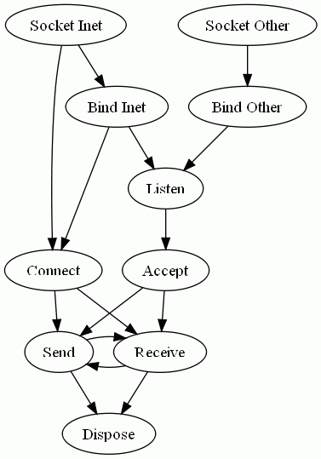
Q.E.D.

